Slide 1



Good Agricultural Practices and Pre-Harvest Contamination
2017 Presentation
Adapted by Dave Martin and Justine Beaulieu
Original by Donna Pahl
Notes:
This presentation was tailored for the On-Farm Food Safety and Recall Readiness trainings for Sarah Everhart in January 2018. The main GAP presentation is the same, but the slides for taking notes in the food safety plan have been removed. –JRB 11/21/17

Slide 2
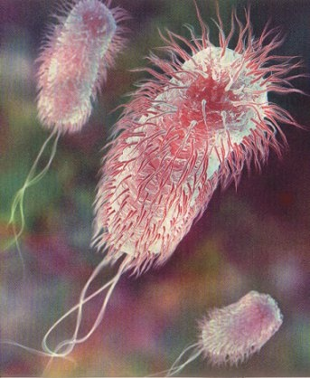
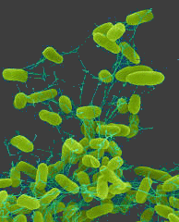
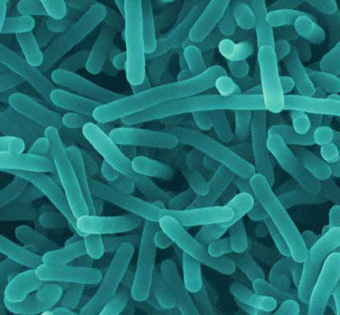
Hazards in Foods
A hazard is something that could cause harm to the consumer.
Hazards commonly associated with fresh produce are:
  Biological hazards
  Chemical hazards
  Physical hazards

Slide 3

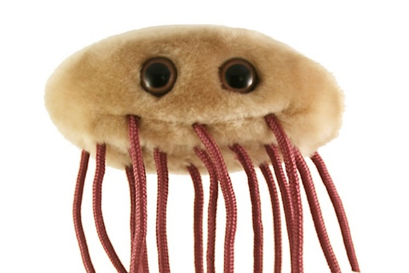
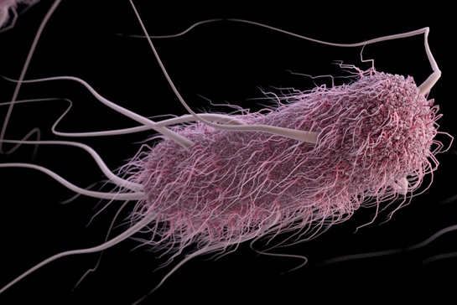
Escherichia coli (E. coli)
Lives in the intestines of animals
Most types are harmless, but some are pathogenic (i.e. they can make you sick)
Contaminated water, soil, and food
  Undercooked ground beef
  Raw milk and juice
  Soft cheeses made from raw milk
  Fresh produce (particularly raw sprouts)
Amazon.com
cdc.gov

Slide 4
E. coli in the News
2016 E. coli O157:H7 outbreak on sprouts in Minnesota (8) and Wisconsin (3). Two hospitalizations. No HUS or deaths.
2012 E. coli O157:H7 outbreak on organic spinach and spring mix blend. 33 persons in five states (NY, MA, CT, PA, VA). Hospitalizations, HUS, no deaths.
2012 E. coli 0126 outbreak on sprouts reaching 29 persons in 11 states (WA, KS, IA, MO, AR, AL, WI, MI, OH, WV, PA). Hospitalizations, no HUS, no deaths.
2006 Fresh spinach: 26 states, 199 people, 3 deaths, 102 hospitalizations, 31 HUS. 22 <5 YO

Slide 5
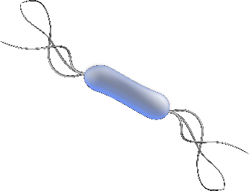
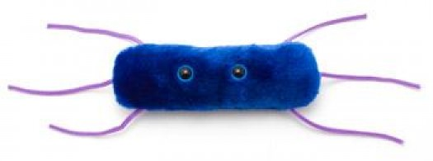
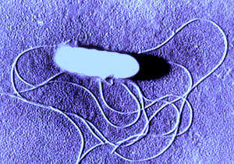
Listeria monocytogenes
Causes Listeriosis or Listeria infection
Found in soil and water and some animals, including poultry and cattle
Caused by eating contaminated food
Raw milk, soft cheeses, some processed meats, refrigerated smoked seafood, raw sprouts
Can grow even in the refrigerator, and will grow faster at temperatures above 40⁰F
Amazon.com

Slide 6
Listeria in the News
2016 Packaged salads reaching 19 people in 9 states (MO, MI, IN, OH, PA, NY, NJ, CT, MA). 19 hospitalizations and 1 death.
2015 Caramel apples reaching 35 people in 12 states (WA, CAL, NV, UT, AZ, NM, CO, TX, MO, MN, WI, NC). 34 hospitalizations and 7 deaths.
2013 Frozen vegetables reaching nine people in four states CT, MD, WA, CA. All hospitalized, three deaths (two were in MD but listeriosis not the direct cause).
2011 Whole cantaloupes reaching 147 in 28 states. 143 hospitalizations, 33 deaths

Slide 7
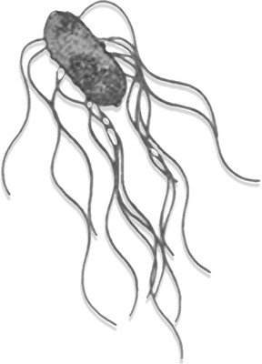
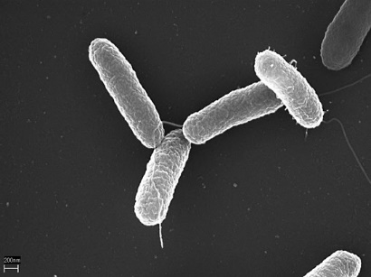
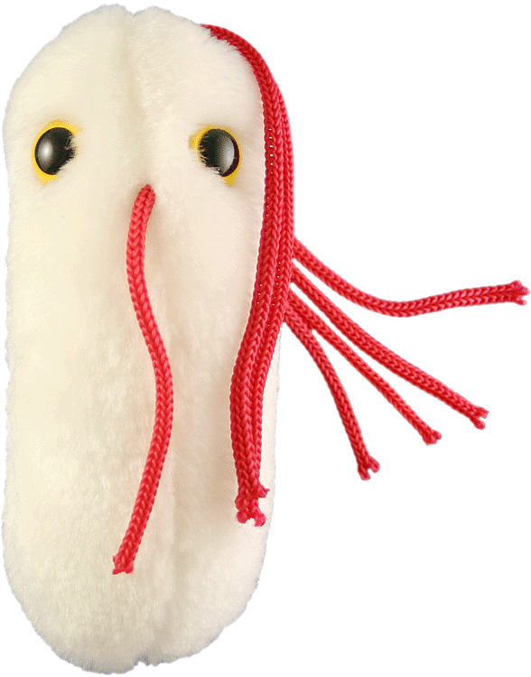
Salmonella
Salmonellosis is the most frequently reported case of foodborne illness
Over 2,300 types
Annual U.S. estimates:
  One million foodborne illnesses
  19,000 hospitalizations
  380 deaths
Diarrhea, fever, abdominal pain for 4-7 days
Foods of animal origin
Scientific Institute of Public Health
Encyclopedia Britannica
Amazon.com

Slide 8
Salmonella in the News
2016 in sprouts reaching 36 people in 9 states. Seven hospitalizations, no deaths
2016 sprouts reaching 26 people in 12 states including MD. Eight hospitalizations, no deaths.
2015 cucumbers reaching 907 people in 40 states. 204 hospitalizations, six deaths.
2014 cucumbers reaching 275 people in 29 states and D.C. 48 hospitalized, one death. Traced back to Delmarva.

Slide 9
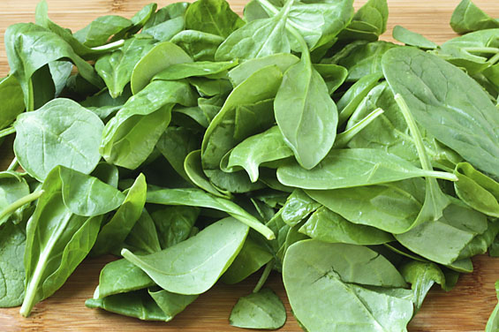
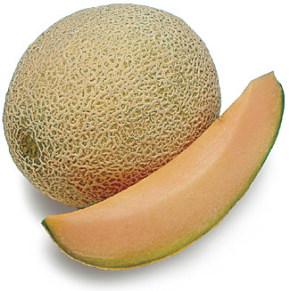
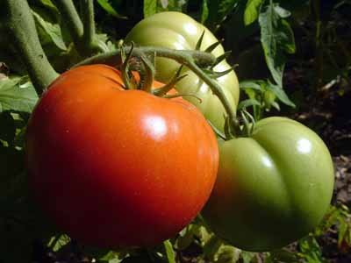
Fresh Fruit and Vegetable Causes and Concerns
Grown in an open environment
Multiple opportunities for contamination
No absolute kill step without damage
Likely to be consumed raw
Yearly consumption of produce increasing
Notes:
In October, 1997, the President announced The Produce and Imported Food Safety Initiative geared towards improving the safety of produce consumed in the US, whether it is produced domestically or imported. This initiative is part of the larger Food Safety Initiative.
As part of the Produce Safety Initiative, the President directed the Secretary of Health and Human Services, and the Secretary of Agriculture, in cooperation with the agricultural community, to develop voluntary guidance on good agricultural and good manufacturing practices (GAPs/GMPs) for the growing and packing of fresh fruits and vegetables.

Slide 10
Is Food Safety Just a Problem for Wholesale Growers? … NO
There are five high-risk fruit and vegetable crops….and we grow and direct-market them all locally:
  Leafy greens (Escherichia coli)
  Tomato (Salmonella enterica and newport)
  Cantaloupe (S. enterica and Listeria monocytogenes)
  Berries (E. coli)
  Green onions (Hepatitis A)

Slide 11
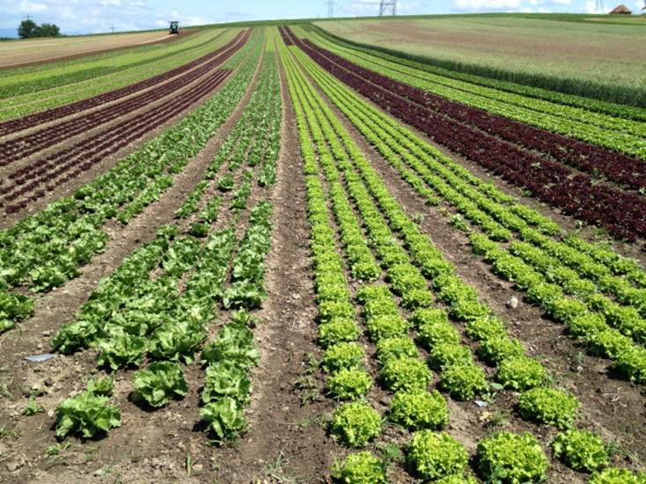
The 4 W’s
Workers
Water
Wildlife
Waste
Our focus is on these four topics

Slide 12
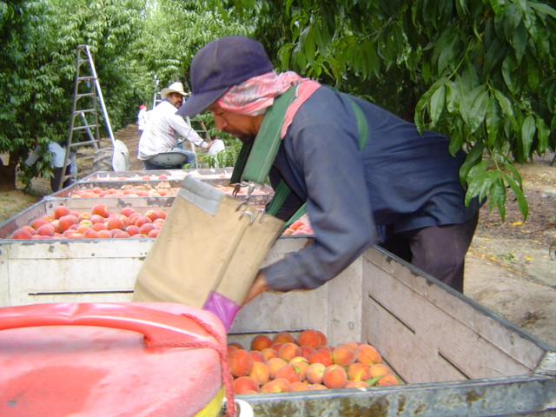
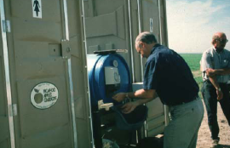
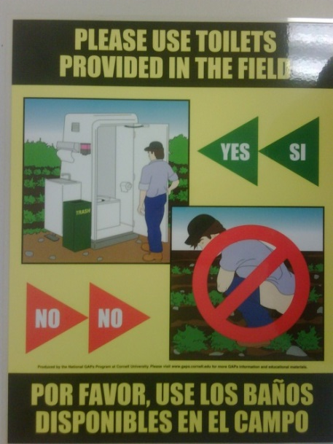
Worker Health and Hygiene
Worker hygiene training
  Washing hands
  Using restrooms
  Screening sick workers
  Injuries and cuts
VERY important in
food safety!
Facilities and
Training

Slide 13
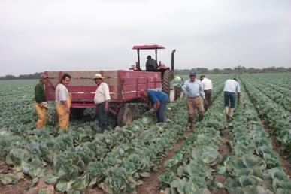
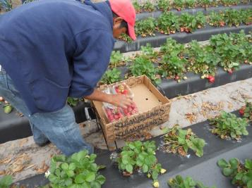
Workers Are A Food Safety Concern Because They…
Can carry human pathogens
  Shigella, Hepatitis A, Norovirus,
  and others
Can spread human pathogens
  Harvest and pack with their hands
  Fecal-oral route
Require training to reduce risks
  Proper handwashing
  How to handle illnesses and injuries
Notes:
Each module will begin with assessing risks. This slide outlines risks posed by workers.
Workers can carry, introduce, and spread contamination to fresh produce while they are working on the farm.
Human pathogens can be spread through many routes; however, the fecal-oral route is most common. This can happen if a worker does not wash their hands after using the toilet and then handles produce, contaminating it with fecal material.
Pathogens can also spread through saliva and mucus, and contact with other contaminated surfaces. For example, hands may become contaminated while eating, smoking, or sneezing.
Workers must wash their hands at times where hands may have become contaminated.
Worker training should include how to wash hands and workers should be given opportunities to practice this skill during the training.
Workers must know what to do if they are ill or injure themselves while working. This reduces the risks of human pathogens, blood, and other bodily fluids contaminating fresh produce, fields, and packinghouses.
Remember, workers and the training they receive are very important since workers play a key role in farm food safety.
Example outbreak: Hepatitis A in Green Onions
Calvin, L., Avendaño, B., Schwentesius, R. (2004). The economics of food safety: The case of green onions and Hepatitis A outbreaks. Electronic Outlook Report from the Economic Research Service. http://www.ers.usda.gov/publications/vgs/nov04/VGS30501/VGS30501.pdf
Centers for Disease Control and Prevention (CDC). (2003). Hepatitis A Outbreak Associated with Green Onions at a Restaurant — Monaca, Pennsylvania, 2003. http://www.cdc.gov/mmwr/preview/mmwrhtml/mm5247a5.htm

Slide 14
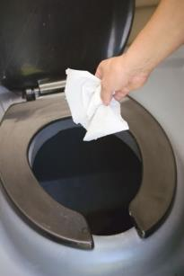
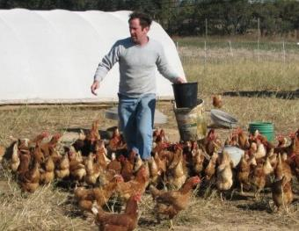
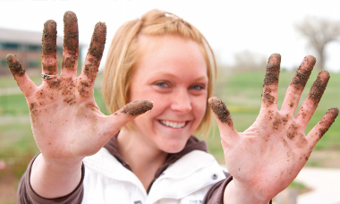
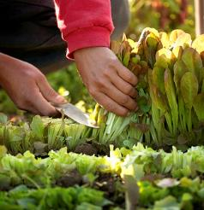
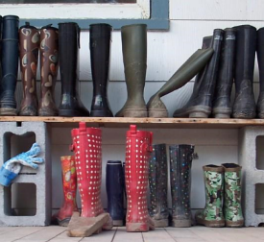
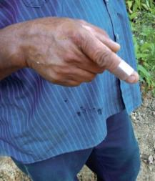
Routes of Contamination
Clothing
Hands
Feces
Tools & Equipment
Footwear
Illness & Injury
Notes:
Here are some ways that workers can introduce contamination.
Feces (poop) can contaminate produce directly if workers defecate (poop) in the field or if there is a leak in the sewage system.
Workers' hands can also cross-contaminate produce if they do not wash their hands after using the toilet or returning from a break (e.g., after eating or smoking) and then handling produce.
Another example of indirect contamination can occur when workers' clothing is contaminated for example, by animal feces, that can be transmitted to covered produce or food contact surfaces. When working with animals or handling manure, workers may need to use protective outer garments (e.g., aprons or coveralls) to protect their clothing from contamination.
Injuries can result in blood or other bodily fluids contaminating produce, so it is also important to stress worker safety on the farm.
Workers can contaminate tools/equipment if proper hygiene practices are not followed.

Slide 15
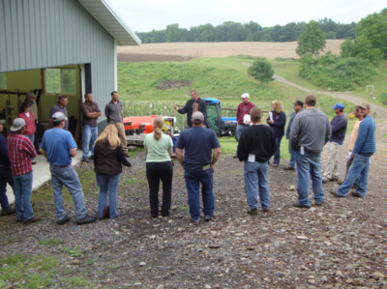
Importance of Training Workers
Fresh fruits and vegetables often receive no additional processing (such as cooking), so contamination with a pathogen can result in illness when the produce is consumed
Workers need to use food safety practices every day to reduce produce safety risks
Food safety practices are learned
so training is key to successful
implementation
Notes:
Fresh fruits and vegetables often do not receive a “kill step” such as processing or cooking before being consumed. Pathogens that contaminate produce can cause foodborne illness if they are consumed.
Workers are a critical part of any Farm Food Safety Plan because they are responsible for using food safety practices every day while they work.
Food safety practices are learned, so training is key to successful implementation.

Slide 16
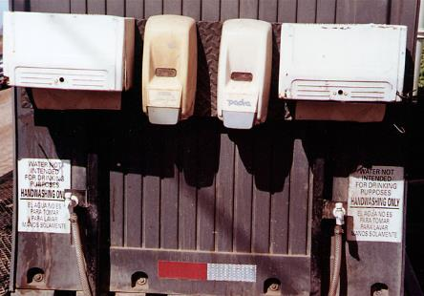
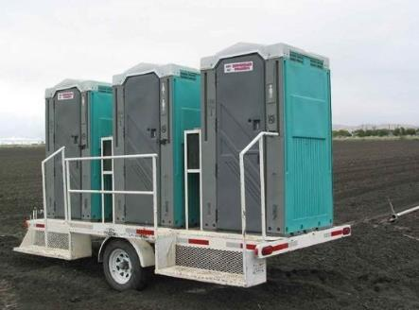
Resources Provided to Support Food Safety Practices
Toilets
Toilet paper
Soap
Clean water
Paper towels
Container to catch wastewater
Garbage cans
First Aid Kit
Break Areas
§
Notes:
As a farm owner and manager, it is important to realize the need to provide the following resources for workers. If toilets, toilet paper, water, soap, and paper towels are not provided, workers will not be able to properly use the toilet, wash their hands, and follow farm food safety policies. It is also important to provide garbage cans, first aid kits and areas where workers can take a break without introducing contamination to fresh produce.
Keep in mind, on small farms, these facilities can be located inside the home or office as long as the same resources are provided.
Reusable towels are not allowed because of the risk of transferring pathogens from one person to another. Single-use paper towels are one acceptable option for workers to use to dry their hands.
§ 112.129(a) requires that toilets must be provided for workers and readily accessible in growing areas during harvest activities, (b) that toilet facilities must be designed, located, and maintained to: (1) Prevent contamination of covered produce, food-contact surfaces, areas used for a covered activity, water sources, and water distribution systems with human waste; (2) Be directly accessible for servicing, be serviced and cleaned at a frequency sufficient to ensure suitability of use, and be kept supplied with toilet paper; and (3) Provide for the sanitary disposal of waste and toilet paper.
§ 112.130(b) requires handwashing facilities have soap, running water, and adequate drying devices to dry hands (such as single service towels, sanitary towel service, or electric hand dryers), (c) requires that appropriate disposal of waste must be provided for dirty towels and wastewater.

Slide 17
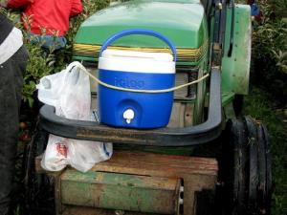
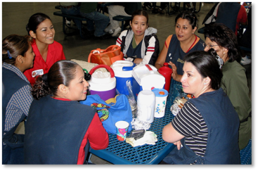
Drinking Water & Break Areas
Workers should be provided with drinking water to reduce the risks of heat exhaustion
Break areas do not need to be a
separate building but must be in a designated area
Healthy workers are better able to do their jobs and implement food safety practices!
§
Notes:
In order for workers to do their job and stay healthy, potable (drinking) water should be provided. This can help reduce the risk of dehydration and heat exhaustion.
OSHA requires that “Potable water shall be provided and placed in locations readily accessible to all employees.”
Single use cups should be provided so that workers are not sharing cups.
If workers are allowed to bring their own water containers, make sure they are plastic (not glass) and that they know where they can refill their containers.
Check local and state regulations regarding worker health and safety. Some states allow “hydration” fluids such as Gatorade™ or have specific requirements for sending workers home if it is too hot outside.
§ 112.32(b)(6) requires not eating, chewing gum, or using tobacco products in an area used for a covered activity (however, drinking beverages is permitted in designated areas).

Slide 18

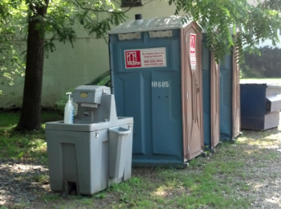
Proper Use of Toilets
All urination and defecation should be done in a toilet, NEVER in the field or nearby production areas
Toilet paper should be deposited into the toilet, not in a garbage can or on the floor
Always wash hands after using
the toilet
§
Notes:
This may seem obvious, but not using the toilets properly is a major food safety risk and happens more often than imagined.
Urinating (peeing) and defecating (pooping) should be done in the toilet, NEVER in the field.
Personnel must be provided with adequate, readily accessible toilet facilities (§ 112.129(a)) and a handwashing station must be in sufficiently close proximity to toilet facilities (§ 112.129(c)).
Facilities should be clean, well-stocked, and close to where people are working (¼ mile or 5 minute walk) to encourage their use. No one likes to use a dirty toilet or give up precious work time to do the right thing.
Some farms using portable toilets prefer to rent or buy portable facilities where the sink is located on the outside of the structure. This facilitates easier monitoring that farm workers are washing their hands after using the toilet.
Certain practices may create greater risks of contamination, such as toilet paper being placed in a garbage can or on the floor next to the toilet. This may require additional training if a grower finds this type of problem on their farm.
Toilet facilities should be monitored daily to ensure they are well-stocked, clean, and working properly.
Workers should be instructed to tell their supervisors if there is a problem so that it can be fixed.

Slide 19
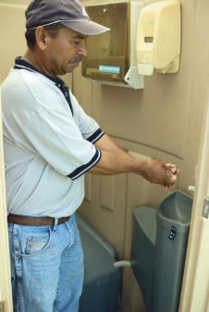
Worker Clothing
Clean clothes should be worn each day
Footwear cleanliness is important
  Designated footwear helps prevent cross-contamination
  Gloves, if worn, must be changed when they become contaminated or torn
  If reusable gloves are used, clean often or as needed
  Aprons, gloves, and other food safety equipment should be removed before using the toilet and should be stored in a clean, designated area when not in use
§
Notes:
Worker clothing and equipment is important because dirty clothes, shoes, and gloves can lead to cross-contamination of produce.
Footwear: Have boots designated for activities that involve animals such as mucking stalls or feeding animals. Do not wear dirty boots (especially those covered in manure or other contaminants) in produce fields or packing areas.
Gloves are not required, but if they are used, they must be changed frequently or cleaned as needed. Gloves are not a substitute for proper handwashing. § 112.32(b)(4) requires that if you choose to use gloves in handling covered produce or food contact surfaces, maintain gloves in an intact and sanitary condition and replace such gloves when no longer able to do so.
If gloves are reusable, they should be cleaned as often as necessary so that they do not become a source of contamination.
Aprons or other food safety equipment should be properly stored when not in use, cleaned on a regular basis, and removed prior to using toilet facilities.
Jewelry worn by workers may present a physical food safety hazard as well as a worker safety risk. Jewelry can become stuck in processing equipment or farm tools which presents a serious safety risk to workers.
Jewelry that cannot be adequately cleaned and sanitized before handling produce must be removed or covered to prevent contamination of produce (§ 112.32(b)(5)).

Slide 20
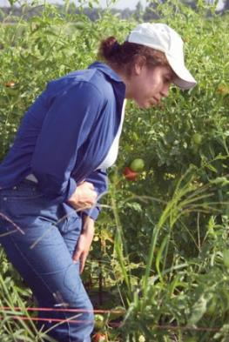
Worker Illness
Workers who are sick or show signs of illness can contaminate fresh produce
Ill workers must not handle fresh produce
Symptoms of illness can include:
  Nausea
  Vomiting
  Diarrhea
  Fever
  Jaundice
§
Notes:
Human pathogens can be easily transferred from sick workers, either through their hands, or from feces, vomit, or other bodily fluids.
Workers may be embarrassed to report an illness and may not want to be sent home for the day which is why a policy needs to be in place.
It is recommended that ill employees should not come to work if there is a risk of contaminating produce or food contact surfaces.
Managers should be trained to recognize when workers are ill, such as frequent trips to the toilet, so they can intervene if necessary.
Heat stress and other non-communicable conditions may also cause vomiting. Workers should be provided adequate water and take precautions to protect themselves from extreme temperatures.
Growers may choose to reassign workers to jobs that do not involve handling produce or food contact surfaces to limit the chance that produce becomes contaminated, while still allowing workers to stay on the job.
§ 112.31(a) requires that growers must take measures to prevent contamination of covered produce and food contact surfaces with microorganisms of public health significance from any person with an applicable health condition (such as communicable illnesses that present a public health risk in the context of normal work duties, infection, open lesion, vomiting, or diarrhea).
§ 112.31(b) requires (1) Excluding any person from working in any operations that may result in contamination of covered produce or food contact surfaces with microorganisms of public health significance when the person (by medical examination, the person’s acknowledgement, or observation) is shown to have, or appears to have, an applicable health condition, until the person’s health condition no longer presents a risk to public health; and (2) Instructing personnel to notify their supervisor(s) (or a responsible party) if they have, or if there is a reasonable possibility that they have an applicable health condition.

Slide 21
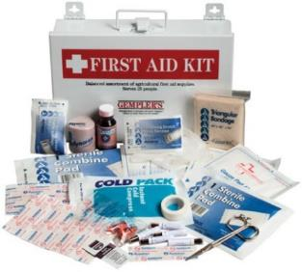
Worker Injury
Worker injuries may pose food safety risks
  A first aid kit should be available, stocked, and monitored
  Clean and bandage all wounds
    If the wound is on the hands, a glove should be worn to create a double barrier
  Discard any produce that may be
  contaminated
  Clean and sanitize any items that
  came in contact with bodily fluids
  Report all injuries to supervisor
Notes:
Make sure the injured worker receives medical attention and if necessary, call 911.
Worker injuries represent a food safety risk because blood and other bodily fluids can contaminate produce, fields, and food contact surfaces.
First aid kits are food safety resources that should be provided for workers.
The first aid kit should be available in a convenient location, whether this be in a truck that goes out to the field with workers, in the packing area, or in the main office. Depending on how many workers are present on the farm, more than one kit may be necessary. All first aid kits should be inspected at least monthly (or more frequently, if needed) to make sure all supplies are stocked.
Any minor wounds should be bandaged. If the wounds are on the hands, they should be bandaged and a glove or ‘fingerbob’ worn over top as a secondary barrier to protect both the worker (i.e., prevent infection) and the produce (i.e., prevent contamination).
Workers should be instructed to tell their supervisor about all injuries.
If blood or bodily fluids are present on fresh produce or food contact areas, be sure to properly clean and sanitize the area and dispose of any contaminated product.

Slide 22
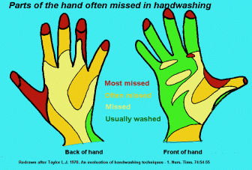
How to wash your hands
1. Wet hands with warm water
2. Apply soap to hands
3. Lather hands for 20 sec.
4. Rinse thoroughly
5. Towel dry thoroughly
with disposable
paper towel

Slide 23
When To Wash Your Hands
After using toilet
After cleaning
restroom
After smoking,
eating or drinking
After changing
diapers or linens
After handling dirty
equipment, utensils
or farm machinery
After caring for or
touching animals
After handling garbage
After engaging in other activities that soil hands
Before you eat
Before you start to work
Before handling food
Between changing tasks or changing gloves

Slide 24
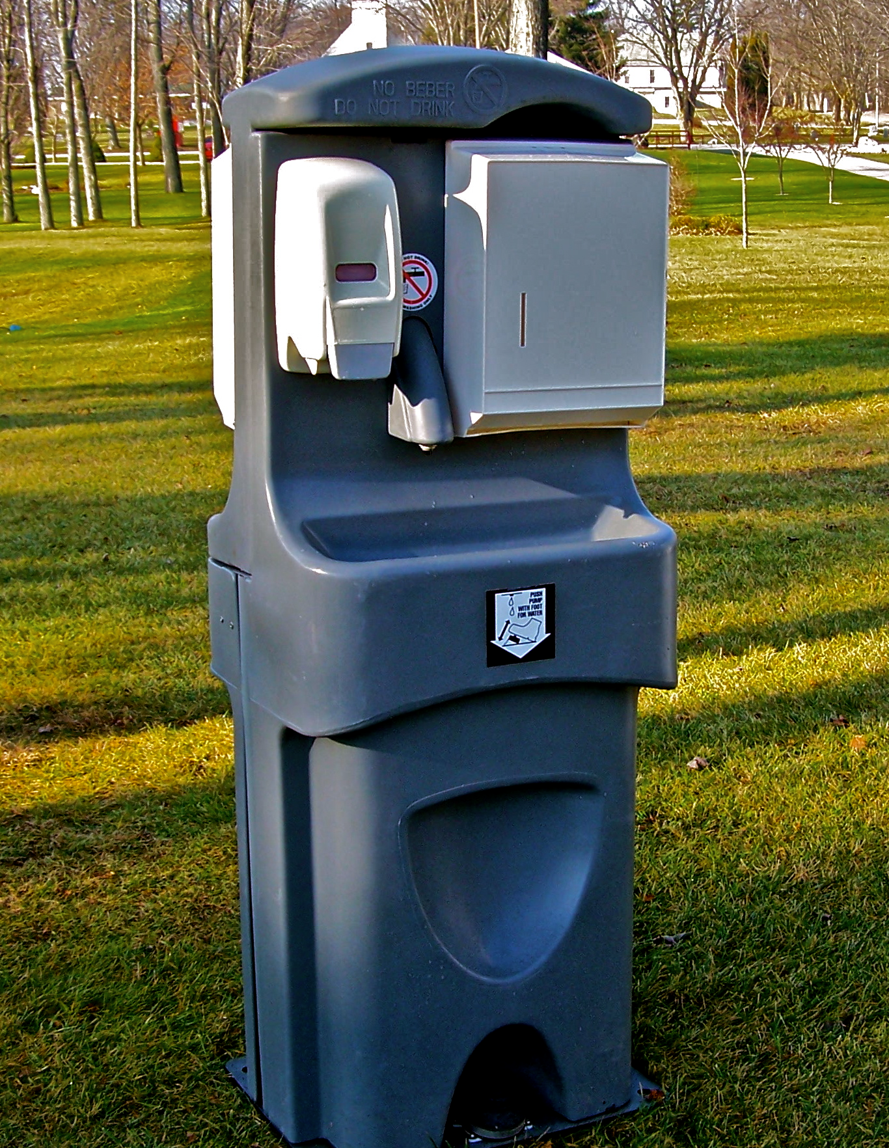
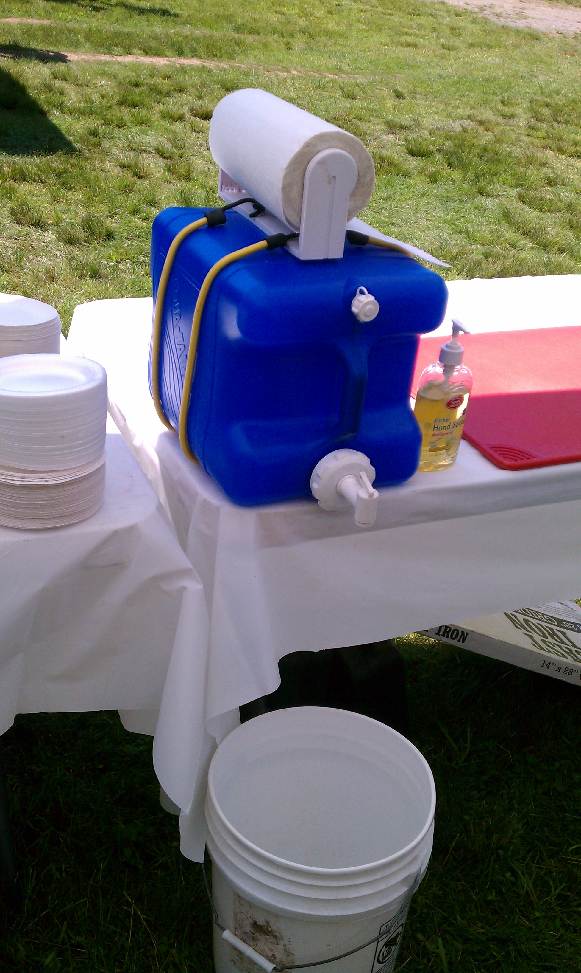
What is required of a hand-washing station?
Potable (drinking) water
Soap
Paper towels (non reusable towels)
Catch basin for grey water
Cannot use just hand sanitizer
Source: www.hallsservall.com, www.doitandhow.com

Slide 25
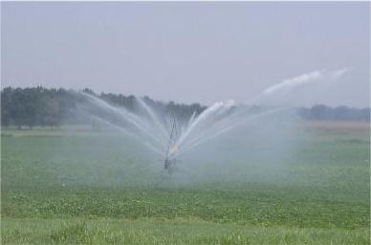
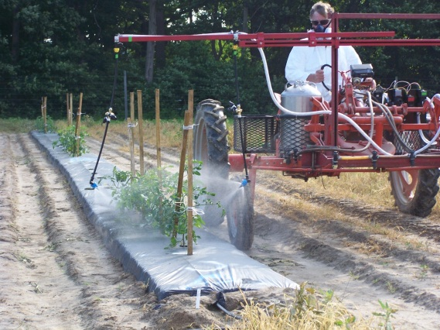
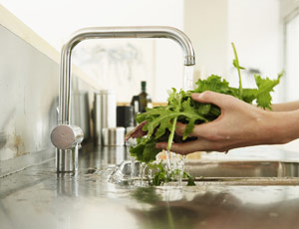
Water Quality: Uses of water in agriculture
  Preharvest
    Irrigation
    Pesticide application
    Frost protection
  Postharvest
    Washing and processing
    Refrigeration and cooling

Slide 26
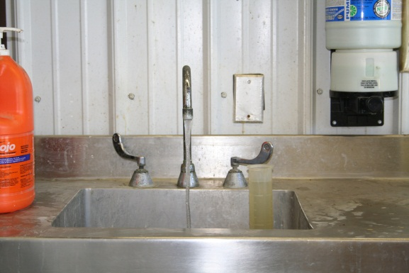
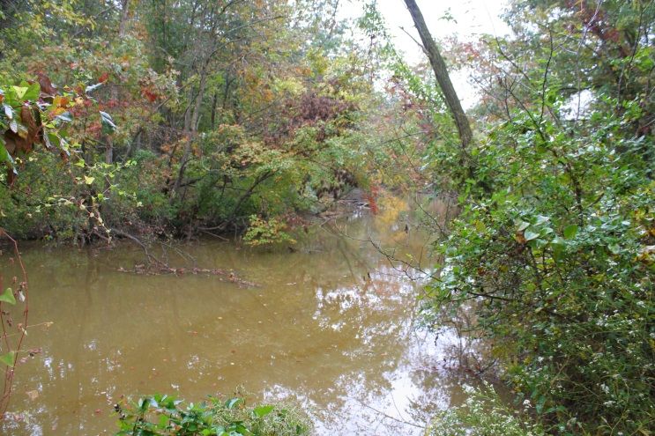
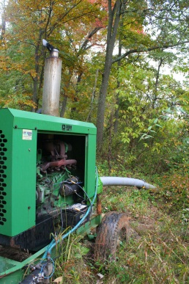
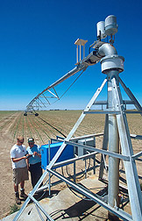
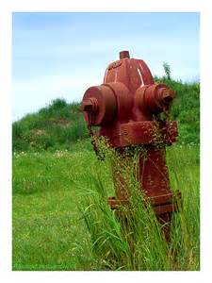
Water Sources
Water for agricultural use may come from:
  Surface sources
    Rivers, streams, irrigation ditches, ponds, and canals
  Wells
  Municipal water systems
high
RISK
USDA
Low
Flicker.com
Notes:
Surface water quality is affected by many environmental influences. Kentucky farmers are accustomed to drawing water from surface ponds for use on their tobacco. Since tobacco isn’t a food crop it has not been a problem in the past. It is our job to look with fresh eyes at the quality of our surface water used for irrigation.

Slide 27
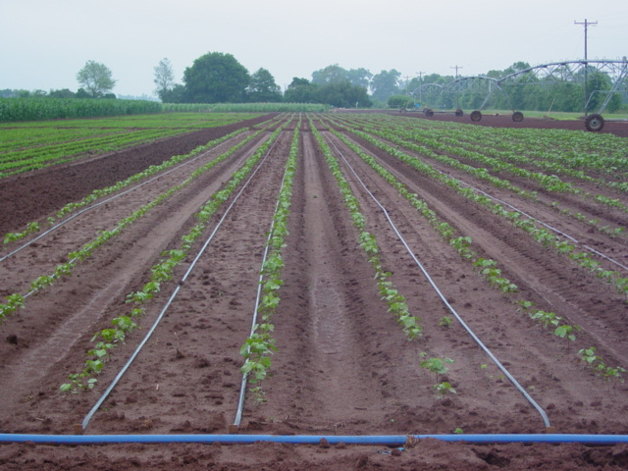
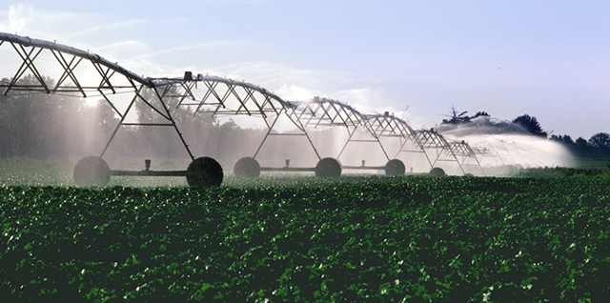
Water Uses in Irrigation
Choose the application method and treatment to reduce risk
    Drip irrigation vs. Overhead irrigation
      Level of microbial contamination in the water?
      How risky is the crop?

Slide 28
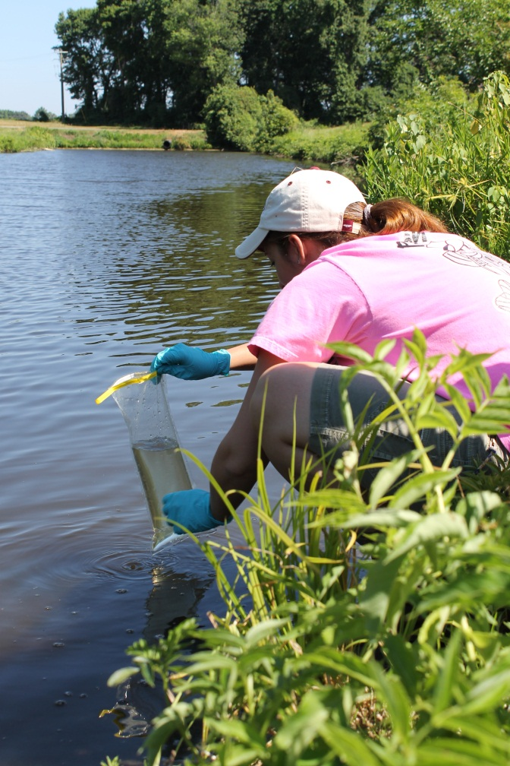
How do you know if your water is suitable for agricultural use?
Test it!
  Send it in to a lab for an E. coli test.

Slide 29
Why Monitor Generic E. coli ?
Species within the fecal coliform group
Indigenous member of the intestinal flora in warm-blooded animals
Used by EPA for drinking and recreational water standards
Not considered to be an environmental organism
Considered the most reliable fecal indicator organism
Notes:
Thus, it’s indicative of fecal contamination
BC it does not reproduce in the environment

Slide 30
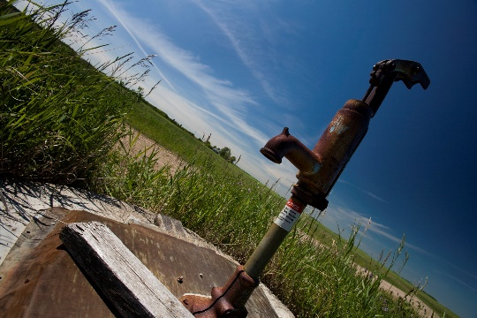


Water tests: How often?
  Well: Once at the beginning of the year
  Surface water: Three times (planting, peak use, harvest)
  City water: Obtain records from municipality
eGFI.com

Slide 31
Water Quality Requirements
Depends on what you’re using the water for:
Irrigation
  Contact water (overhead irrigation): Average of 126 colony forming units (CFUs) in a 100 mL generic E. coli water sample with no one sample above 235 CFUs.
  Non-contact water (drip irrigation): Average of 126 colony forming units (CFUs) in a 100 mL generic E. coli water sample with no one sample above 575 CFUs.
Pesticide spray water: “Microbially safe” <1 or 0 CFU generic E. coli in a 100 mL water sample.
Post-harvest water (water coming into contact with produce during/after harvest, handwashing and drinking water): 0 CFU total coliforms in a 100 mL water sample.

Slide 32

Mitigation Strategies
Investigate what is causing the elevated microbial counts
  Obvious animal contamination or runoff?
  Is the irrigation intake sucking up sediment?
  Cracked well casing?
  Weather?
Consider an alternative water source
  Switch to a different water source a few weeks before harvest?
Use less risky irrigation methods (for example trickle)

Slide 33






Wildlife (Wild and Domestic Animals)
Snake under tractor wheel

Slide 34


Animals Are A Produce Safety Concern Because They:
Can carry human pathogens
  e.g., E. coli O157:H7, Salmonella,
  Listeria monocytogenes
Can spread human pathogens
  By depositing feces in fields
  By spreading fecal contamination as they move
Are very difficult to control
  Birds and small animals travel unnoticed
  If fencing is used, even the best fence can be breached
  Complete exclusion is not possible
Notes:
When assessing risks associated with domesticated and wild animals, it is important to understand that they are a food safety concern because animals can carry human pathogens in their feces and can spread contamination around fields as they move.
Domesticated animals, due to their close proximity to humans as well as other wildlife, are more likely to harbor human pathogens.
Animals are naturally present in the environment and difficult to control, so complete exclusion is not possible. Knowing this, it is still important to limit their access to fields and work to ensure contaminated produce is not harvested.
The presence of wildlife and domesticated animals is not an inherent problem, but their presence can pose risks since animals can serve as reservoirs for human pathogens.
In Subpart I, these three provisions § 112.81, § 112.83, and § 112.84 include standards directed to minimize the potential for biological hazards from animal excreta to be deposited by domesticated animals on the farm, by domesticated animals from a nearby area or by wild animals (such as deer and wild swine) on covered produce, or in an area where growers conduct a covered activity on covered produce.
§ 112.83(a) requires that those subject to the rule take the steps as outlined in §112.83(b) if there is a reasonable probability that grazing animals, working animals, or animal intrusion will contaminate covered produce.
The requirements outlined in § 112.81, § 112.83, and § 112.84 apply when a covered activity takes place in an outdoor area or a partially-enclosed building and when, under the circumstances, there is a reasonable probability that animals will contaminate covered produce (§ 112.81(a)).
The requirements in § 112.81, § 112.83, and § 112.84 do not apply when the covered activity takes place in a fully-enclosed building. These requirements also do not apply to fish used in aquaculture operations (§ 112.81(b)). Some other requirements in Subpart L related to domesticated animals and pests are covered in Module 6: Postharvest Handling and Sanitation.
Additional Resources:
Langholz, J., & Jay-Russell M. (2013). Potential role of wildlife in pathogenic contamination of fresh produce. Hum Wildlife Interact, 7(1), 140–157.
Jay, M.T., Cooley, M., Carychao, D., Wiscomb, G.W., Sweitzer, R.A., Crawford‐Miksza, L., Farrar, J.A., Lau, D.K., O'Connell, J., Millington, A., Asmundson, R.V., Atwill, E.R., & Mandrell, R.E. (2007). Escherichia coli O157:H7 in Feral Swine near Spinach Fields and Cattle, Central California Coast. Emerg Infect Dis, 13(12), 1908–1911.

Slide 35

Wildlife on the Farm
Can be a natural and valuable part of
the landscape and farm environment
Depending on species, management options may be limited by county, state, or federal law
May be resident or transient (e.g., migrating species)
Wildlife with close association to human activities may pose greater risks
  e.g., seagulls feeding at dumps, starlings feeding in cattle feedlots
Notes:
Wildlife on the farm is natural and their presence is often unavoidable. Some types of wildlife can be beneficial to farm production, such as raptors or predator mammals that reduce rodent populations.
Controlling wildlife is a complex process and may require multiple strategies.
There are county, state, and federal laws that protect some wildlife species. Be sure your management practices are legal and effective. Contact a USDA Natural Resources Conservation Service (NRCS) specialist or Extension professional to learn about protected species and acceptable management practices.
There is research to indicate wildlife associated with human activities (such as close proximity to cattle feedlots or garbage dumps) may present greater risk of spreading pathogenic microorganisms than other wildlife not associated with these feeding places, so consider activities that occur on or near the farm when assessing risks for this type of wildlife activity.
§ 112.83(a) requires that if there is reasonable probability that animal intrusion will contaminate produce, that those areas used for growing covered produce are monitored as needed during the growing season and immediately prior to harvest.
§ 112.84 states that nothing in the regulation authorizes the “taking” of threatened or endangered species as that term is defined by the Endangered Species Act (16 U.S.C. 1531-1544) (i.e., to harass, harm, pursue, hunt, shoot, wound, kill, trap, capture, or collect, or to attempt to engage in any such conduct), in violation of the Endangered Species Act. The regulation does not require covered farms to take measures to exclude animals from outdoor growing areas, or to destroy animal habitat or otherwise clear farm borders around outdoor growing areas or drainages.

Slide 36


Assessing Risks: Wildlife
Do you find wildlife feces in your produce fields?
  How often? Is it widely distributed? Is it in contact with produce?
Is your farm in an area that large numbers of animals visit
(e.g., flocks of migrating birds, herds of deer)?
What management practices can limit wildlife contamination of produce fields and water sources?
Notes:
Wildlife is more of a challenge to control on the farm than domesticated animals because wildlife are not under the control of the farm. Wildlife may have access to farm land that is adjacent to conservation land or other natural areas.
Many growers already deter wildlife because they are concerned with crop damage and destruction.
Wildlife entering fields or packing areas is a key concern, especially if significant evidence of potential contamination, such as the observation of animals, animal excreta, or crop destruction, is identified. § 112.83 (b)(2) requires that if significant evidence of potential contamination is found (such as observation of animals, animal excreta or crop destruction), you must evaluate whether the covered produce can be harvested in accordance with the requirements of § 112.112 and take measures reasonably necessary during growing to assist you later during harvest when you must identify, and not harvest, covered produce that is reasonably likely to be contaminated with a known or reasonably foreseeable hazard.
Regardless of what risks exist, all growers should be aware of how their actions may affect wildlife and natural habitats. Co-management is discussed in more detail in the next few slides.
Additional Resources:
Nielsen, E.M., Skov, M.N., Madsen, J.J., Lodal, J., Jespersen, J.B., & Baggesen, D.L. (2004). Verocytotoxin-producing Escherichia coli in wild birds and rodents in close proximity to farms. Appl Environ Micro, 70(11), 6944–6947.
Laidler, M.R., Tourdjman, M., Buser, G.L., Hostetler, T., Repp, K.K., Leman, R., Samadpour, M., Keene, W.E. (2013). Escherichia coli O157:H7 infections associated with consumption of locally grown strawberries contaminated by deer. Clin Infect Dis, 57(8), 1129–1134.
Gruszynski, K., Pao, S., Kim, C., Toney, D., Wright, K., Ross, P.G., Colon, A., & Levine, S. (2014). Evaluating Wildlife as a Potential Source of Salmonella serotype Newport (JJPX01.0061) Contamination for Tomatoes on the Eastern Shore of Virginia. Zoonoses and Public Health, 61(3), 202–207.

Slide 37

Monitoring Wildlife Activity
During the growing season:
  Monitor for feces and evidence of intrusion
  Evaluate the risk of fecal contamination
  on produce (e.g., tree vs. root crop)
  Consider past observations and wildlife attractants
Immediately prior to harvest
  Monitor for fecal contamination, signs of animal activity (e.g., trampling, rooting, feeding, tracks)
  Assess risks and decide if the crop or a portion of the crop can be safely harvested
Notes:
Monitoring wildlife activity throughout the growing season is helpful for preventing crop contamination and loss. Additionally, monitoring may allow growers to develop an understanding of when and to what degree animal intrusion occurs throughout the season, allowing them to develop more effective animal management practices.
Consider crop characteristics when monitoring for food safety risks associated with wildlife. Tree crops and crops grown off the ground are less likely to be contaminated by small rodents and mammals since they do not grow where feces are likely to be deposited, but resident bird populations or migrating flocks, such as crows, might be more likely to directly affect a tree crop.
Consider factors that might lead to increased animal movement toward crop and/or water sources, for example drought, post-wildfire conditions, or other events that influence animal movement patterns.
As mentioned in previous slides, § 112.83(b) requires those subject to the rule assess relevant areas used for a covered activity for evidence of potential contamination of covered produce as needed during the growing season (based on covered produce; practices and conditions; and observations and experience) and; if significant evidence of potential contamination is found (such as observation of animals, animal excreta or crop destruction), those subject to the rule must evaluate whether the covered produce can be harvested in accordance with the requirements of § 112.112 and take measures reasonably necessary during growing to assist them later during harvest when they must identify, and not harvest, covered produce that is reasonably likely to be contaminated with a known or reasonably foreseeable hazard.
In Subpart K, § 112.112 requires those subject to the rule must take all measures reasonably necessary to identify, and not harvest, covered produce that is reasonably likely to be contaminated with a known or reasonably foreseeable hazard, including steps to identify and not harvest covered produce that is visibly contaminated with animal excreta. At a minimum, identifying and not harvesting covered produce that is reasonably likely to be contaminated with animal excreta or that is visibly contaminated with animal excreta requires a visual assessment of the growing area and all covered produce to be harvested, regardless of the harvest method used.

Slide 38
Assessing Risks:
Domesticated Animals
Are domesticated animals allowed in the field while the crop is present as part of the production process?
  Are they working animals?
Are workers aware of cross-contamination risks from fecal contamination of hands, clothing, shoes, and equipment after handling animals or fecal material?
Are production fields rotated into grazing land?
  If manure is present on the ground, one recommendation is to extend the period of time between when animals were grazed and when produce can be planted
Notes:
In the case of domesticated animals on the farm, there are usually more opportunities to exclude and control animals from entering produce fields and water sources than with wildlife.
If using animals during production (such as horses), it is important to think about when and how often they are in the field. Is the crop present? Risks vary depending on the developmental stage of the covered produce (edible portion present) and when animals are present. Always consider the risk of fecal contamination to covered produce.
It is also important to think about where produce fields and packing areas are in relationship to pastures and areas where animals live.
Is runoff of manure or urine a concern?
Are animals controlled so that they do not have access to fields and packing areas? This includes pets, especially close to harvest.
Are the people that work with animals (and animal manure) aware of cross-contamination risks from hands and clothing such as boots?
§ 112.32(b)(2) requires that any workers in direct contact with working animals take appropriate steps to minimize the likelihood of contamination of covered produce, and § 112.32(b)(3)(v) requires thoroughly washing hands as soon as practical after touching animals or any waste of animal origin.
Module 3: Soil Amendments covers considerations of using or storing manure or compost on the farm so that it does not become a source of contamination, and also covers the requirements of Subpart F.
§ 112.83 states that if there is reasonable possibility that grazing animals, working animals, or animal intrusion will contaminate covered produce, those subject to the rule must assess relevant areas for evidence of potential contamination of covered produce as needed during the growing season. If significant evidence of potential contamination is found during growing (such as observation of animals, animal excreta, or crop destruction), they must evaluate whether the covered produce can be harvested under § 112.112 and take measures reasonably necessary during growing to assist with identifying and not harvesting covered produce reasonably likely to be contaminated with a known or reasonably foreseeable hazard.
§ 112.134(a) requires that if those subject to the rule have domesticated animals, to prevent contamination of covered produce, food contact surfaces, areas used for a covered activity, agricultural water sources, or agricultural water distribution systems with animal waste, they must:
Adequately control their excreta and litter; and
Maintain a system for control of animal excreta and litter
Additional Resource:
Wang, G., Zhao, T., & Doyle, M.P. (1996). Fate of enterohemorrhagic Escherichia coli O157:H7 in bovine feces. Appl Environ Micro, 62(7), 2567–2570.

Slide 39



Pets
Should be excluded from produce fields
Visitors to the farm should be instructed to leave their pets at home
Farms with petting zoos should have handwashing sinks available and signage instructing visitors of the food safety policies
Notes:
Dogs and cats are almost ubiquitous on family farms. Farmers should recognize that pets can represent a food safety risk if they have access to fields and packing areas.
Pets can sometimes be effective working animals, such as in the case of dogs that control wildlife.
Working dogs and cats are not prohibited in the FSMA Produce Safety Rule, however, their presence should be monitored and a corrective action plan established for their presence. See the previous slide for more information on working animals.
Some growers like to use cats in their packinghouses as rodent control, but cats can carry Toxoplasma gondii, which can cause severe illness including blindness, miscarriage, and death. Because of these and other risks, cats must be excluded or separated from areas where covered produce activities performed in fully enclosed buildings (§ 112.127).
Many farms also have U-pick operations. Instruct U-pick customers to leave their pets at home, for both food safety and liability reasons!
Lastly, if the farm has a petting zoo or any other type of activity that involves workers or visitors touching animals, handwashing stations should be available. This is especially important if a U-pick farm is set up to allow visitors to wander from the animal barn (i.e., petting the animals) to the fields (i.e., picking fruit) where customers are likely to be eating or touching produce. There have been several foodborne illness outbreaks associated with petting zoos.
Additional Resources:
Hale, C.R., et al. (2012). Estimates of enteric illness attributable to contact with animals and their environments in the United States. Clin Infect Dis, 54(suppl 5), S472–S479.
Roug, A., Byrne, B.A., Conrad, P.A., & Miller, W.A. (2013). Zoonotic fecal pathogens and antimicrobial resistance in county fair animals. Comparative Immune, Micro, and Infect Dis, 36(3), 303–308.

Slide 40
Animal Exclusion and Control
Hunting
  controlled hunting of hogs, deer and other wild animals may be permitted
Control
  Traps eg. rodent control
  Restrictions on poison (away from produce)
Buffer zones around fields
Construction of barriers
  fences, deer gates, electric fences
Deterrent devices
  scarecrows, propane cannons
Notes:
Fences must be high to prevent deer from jumping over. Inspections to notice any damage – hogs can be very destrcutive, some animals can burrow – ground hog

Slide 41


Waste (animal manure)
Abundant supply
Great source of nutrients
Great way to recycle waste
Great for soil health
  BUT …
Can harbor human pathogens

Slide 42

Survival of Pathogens in Manure
From: JIFSAN GAPs Train the Trainers Manual
Survival depends on:
- Temperature (5C=41F; 22C=72F; 37C=99F)
- Environmental medium
- Water availability

Slide 43

Current Manure Standards
National Organic Program
Must incorporate the manure within two weeks of application (NOP Std. not Nutr. Mgt.)
Earlier FDA FSMA proposal was modified to NOP

Slide 44
Compost vs. Manure
Unless the compost has been produced under very strictly regulated circumstances then treat it as manure
Maintain a Compost Log …
(if you don’t write it down; it didn’t happen)
Notes:
As we refer to compost in this next presentation you need to know how we define the term compost. Because compost has undergone a “cooking” process it doesn’t carry the same potential for contaminating that manure does.

Slide 45
33C= 91F; 42C= 108F; 59C= 138 F; 74C= 165F

Slide 46


Compost
Active composting “rules”:
- Compost must heat up to 131˚F -- 170˚F for 15 days
- Compost must be turned 5 times during the process
- C:N ratio between 25:1 and 40:1
Amendment | Contact | Time Interval
Composted | Contact | 0 days
Treated by physical or chemical means | Contact/no contact | 0 days

Slide 47

Questions?

