Slide 1

Food Safety Modernization Act
PRODUCE SAFETY RULE
Standards for the Growing, Harvesting, Packing, and Holding of Produce for Human Consumption
Deanna Baldwin
Program Manager, Food Quality Assurance

Slide 2
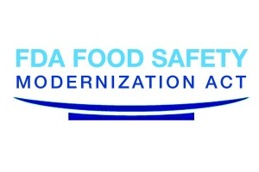
The Food Safety Modernization Act (FSMA)
FSMA includes:
  Produce Safety Rule
  Preventive Controls for Human Food
  Preventive Controls for Animal Food
  Foreign Supplier Verification Programs
  Accreditation of Third-Party Auditors/Certification Bodies
  Sanitary Transportation of Human and Animal Food
  Prevention of Intentional Contamination/Adulteration
Focused on prevention of food safety issues – Farm to Fork
Notes:
The Food Safety Modernization Act (FSMA) was signed into law on January 4, 2011 by President Obama. It is the most sweeping reform of the United States’ food safety laws in over 70 years. The overall objective of FSMA is to focus on prevention of food safety issues.
There are seven primary rules included within FSMA:
Produce Safety Rule which includes Standards for the Growing, Harvesting, Packing, and Holding of Produce for Human Consumption
Preventive Controls for Human Food
Preventive Controls for Animal Food
Foreign Supplier Verification Programs
Accreditation of Third-Party Auditors/Certification Bodies
Sanitary Transportation of Human and Animal Food
Prevention of Intentional Contamination/Adulteration
Additional Resource:
FDA Factsheet. Background on the Food Safety Modernization Act. http://www.fda.gov/Food/GuidanceRegulation/FSMA/ucm239907.htm

Slide 3
Produce Rule Five Year Cooperative Agreement with FDA
FDA has recognized regulation of the growing and harvesting of produce is different than regulation of manufactured food
  Most Health Departments that conduct manufactured food inspections are not familiar with agricultural practices
  Regional differences in available water, climate and growing practices
  State Departments of Agriculture know regional differences and agricultural practices
FDA requested proposals for the states to enter into an agreement to provide a “State Produce Safety” Program

Slide 4
Maryland Produce Safety Program
MDA was awarded a funded agreement with FDA to develop and implement a “Maryland Produce Safety Program”
  FDA oversight
    Ensure that MDA’s Program is equivalent to the federal rule
  Must meet the same standards as the FDA Produce Safety Rule
  MDA has partnered with University of Maryland Extension, University of Maryland Plant Sciences and University of Maryland Agricultural Law Initiative to develop and implement the Program

Slide 5
Produce Rule Five Year Cooperative Agreement with FDA
Inventory - MDA
  Used to determine resources needed for training, technical assistance, and inspection
  MDA required to share information with FDA
    Information on sales and other commercial confidential information will not be released under Maryland Public Information Act
  Growers can expect mailings from MDA requesting:
    Contact information for the farm
    Information that would establish categories (exempt, qualified exempt, fully covered) and compliances dates for the farm
      Gross sales of Food
      Types of Crops (Potatoes vs. Tomatoes)
      Crops destined for further processing with pathogen reduction step

Slide 6
Produce Rule Five Year Cooperative Agreement with FDA
Outreach Activities – MDA, UMD, UME
Make Maryland produce growers aware of the Produce Rule and Resources available
  MDA website FSMA page http://mda.maryland.gov/fsma
  Mail and email informational flyers to farmers
  Training for Extension Agents
  Presentations at Grower meetings

Slide 7
Produce Rule Five Year Cooperative Agreement with FDA
Education, Training, Assistance
  MDA, UMD, UME
  Provide formal and informal training
    Produce Safety Alliance Curriculum
    Supplemental training to assist with implementation of practices
  Provide technical assistance to produce growers
  Provide Readiness Reviews prior to mandated inspections
    Joint non regulatory inspections by MDA Inspectors/UMD/UME
    Identify any areas that may not be in compliance
    UMD and UME can assist growers with correcting these areas
  Identify cost share, low cost loans, grants and other assistance for growers to implement food safety practices

Slide 8
Produce Rule Five Year Cooperative Agreement with FDA
Inspection and Enforcement – MDA
  Adopt regulations that are equivalent to the FSMA Produce Rule
  Prioritize and conduct inspections based on compliance dates and risk
    MDA will conduct inspections – not FDA
  Enforcement Actions
    Severity based on public health risk of non compliance
  Produce and /or Environmental Sampling
    Only conducted when implicated in an outbreak or inspection indicates high risk of contamination

Slide 9
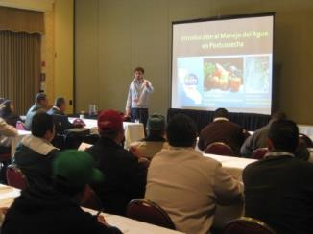
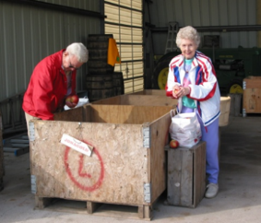
Worker Health, Hygiene and Training
All workers that handle or contact covered produce or supervise covered activities must be trained
  Managers, farm workers, office staff,
  volunteers, interns, family members
  Training Programs must include:
    Principles of food hygiene and food safety
    Personal hygiene and it’s relationship to food safety
    Supervision by a qualified person
    Appropriate instruction relevant to the person’s duties
    Documentation of date, names of those trained and topics that were covered
    One person on the farm must attend FDA recognized training curriculum
      Produce Safety Alliance Produce Safety Rule
Visitors must be made aware of the farm’s food safety policy
  Practices they are responsible for doing
  How to report food safety risks they see
Notes:
All workers that handle or contact covered produce or supervise covered activities must be trained (§ 112.22(a)). However, everyone who works on the farm should understand the company’s food safety policies.
Paid workers, volunteers, interns, pesticide applicators, and even family members can impact the safety of fresh produce. Anyone on the farm who does not wash their hands properly can contaminate produce or food contact surfaces through direct contact, or spread contamination indirectly to others by touching door knobs or other non-food contact surfaces.
Training all members of the farm on food safety helps each employee know their responsibilities and helps identify potential risks that someone else may not see. Remember, everyone should be actively involved in identifying and reducing risks.
Most importantly, owners, managers, and supervisors need to be committed to food safety AND set a good example for workers and visitors to ensure that their policies are followed.
In addition to the training requirements for supervisors of those that handle covered produce during covered activities, § 112.22(c) requires that at least one supervisor from the farm complete food safety training at least equivalent to the standardized curriculum recognized by the FDA. This curriculum satisfies that requirement.

Slide 10
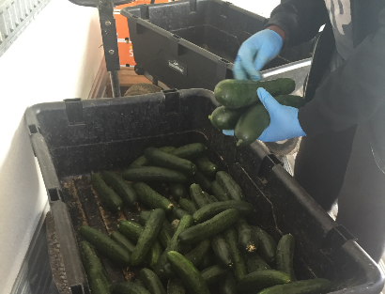
Workers Must
  Maintain personal cleanliness
  Avoid contact with animals (other than working animals)
  Maintain gloves in a sanitary condition, if used
  Wear clean clothes each day/clean footwear
  Be provided with a sufficient number of toilets and sinks
  Remove or cover hand jewelry that cannot be cleaned
  Not eat, chew gum, or use tobacco in an area used for a covered activity
  Not work in contact with food when ill
  Wash their hands
§
Notes:
§ 112.32 lists required practices that must be followed by workers, including:
Maintaining adequate personal cleanliness to protect against contamination of covered produce and food contact surfaces
Avoiding contact with animals, other than working animals, and taking appropriate steps to minimize the likelihood of contamination of covered produce when in direct contact with working animals
Washing hands, discussed on the slide When Must Hands Be Washed?
Maintaining gloves in intact and sanitary condition
Removing or covering hand jewelry that cannot be adequately cleaned and sanitized during periods in which covered produce is handled
Not eating, chewing gum, or using tobacco products in an area used for a covered activity
Other important subjects to include in a training program are:
What to do if they become ill or experience an injury while working, how to locate the first aid kit, how to handle cuts or injuries, and how to report an injury/illness
Specific food safety policies and practices that apply to their daily tasks
Who to tell if they see a food safety risk and that their managers will take this seriously
Consider positive reinforcement for reporting a food safety risk or following safe procedures. For example, farm hats for those who set good examples and follow outlined procedures.

Slide 11
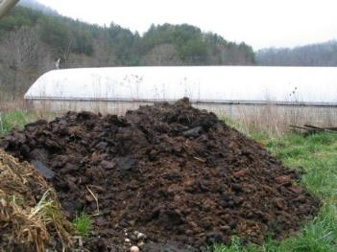
Biological Soil Amendments
Human waste is prohibited unless it meets EPA regulation for biosolids
Untreated biological soil amendments of animal origin considered high risk
  Minimum Application Interval - Current 90/120 days prior to harvest
  Treat to reduce risk
    Compost
    Heat/drying
    Records – Treatment process or record from seller of treatment storage process
Designate specific equipment and tools for handling soil amendments
Sanitize equipment and tools that contact soil amendments and fresh produce
Direct traffic (foot/equipment) to minimize cross-contamination
Store to minimize runoff, leaching and wind drift
Notes:
As a reminder, § 112.51(b) defines untreated soil amendments.
Raw manure, aged manure (meaning no specific process, such as composting, has been followed), untreated slurry, agricultural teas from raw manure, and other raw or incompletely treated products (such as untreated bone meal and blood meal) are examples of higher risk soil amendments.
If a treated soil amendment is mixed with raw manure or incompletely treated manure by accident (or intentionally), or if you have reason to suspect a finished compost has become contaminated, it must be handled as a raw, untreated soil amendment (§ 112.52).
There are treatment options, such as composting or heat treatments, that will reduce food safety risks. The FSMA Produce Safety Rule standards for composting processes will be outlined in the next slides.
Additional Resources:
Jiang, X., Morgan, J., & Doyle, M.P. (2002). Fate of Escherichia coli O157:H7 in Manure‐Amended Soil. App Environ Micro, 68(5), 2605–2609.
Ingram, D., & Millner, P. (2007). Factors affecting compost tea as a potential source of Escherichia coli and Salmonella on fresh produce. J Food Prot, 70(4), 828–834.
Kim, J., Shepherd, J., Marion, W., & Jiang, X. (2009). Evaluating the Effect of Environmental Factors on Pathogen Regrowth in Compost Extract. Micro Ecology, 58(3), 498–508.

Slide 12
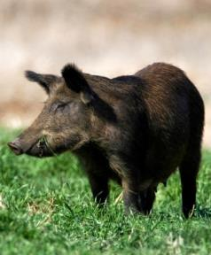
Wildlife, Domesticated Animals, and Land Use
Wildlife
  During the growing season:
    Monitor for feces and evidence of intrusion
    Evaluate the risk of fecal contamination
    on produce (e.g., tree vs. root crop)
  Immediately prior to harvest
    Monitor for fecal contamination, signs of animal activity (e.g., trampling, rooting, feeding, tracks)
    Assess risks and decide if the crop or a portion of the crop can be safely harvested
Domesticated Animals
  Exclude and control animals from entering produce fields
  Minimize cross contamination from grazing areas and produce
Records – Worker Training
Notes:
Monitoring wildlife activity throughout the growing season is helpful for preventing crop contamination and loss. Additionally, monitoring may allow growers to develop an understanding of when and to what degree animal intrusion occurs throughout the season, allowing them to develop more effective animal management practices.
Consider crop characteristics when monitoring for food safety risks associated with wildlife. Tree crops and crops grown off the ground are less likely to be contaminated by small rodents and mammals since they do not grow where feces are likely to be deposited, but resident bird populations or migrating flocks, such as crows, might be more likely to directly affect a tree crop.
Consider factors that might lead to increased animal movement toward crop and/or water sources, for example drought, post-wildfire conditions, or other events that influence animal movement patterns.
As mentioned in previous slides, § 112.83(b) requires those subject to the rule assess relevant areas used for a covered activity for evidence of potential contamination of covered produce as needed during the growing season (based on covered produce; practices and conditions; and observations and experience) and; if significant evidence of potential contamination is found (such as observation of animals, animal excreta or crop destruction), those subject to the rule must evaluate whether the covered produce can be harvested in accordance with the requirements of § 112.112 and take measures reasonably necessary during growing to assist them later during harvest when they must identify, and not harvest, covered produce that is reasonably likely to be contaminated with a known or reasonably foreseeable hazard.
In Subpart K, § 112.112 requires those subject to the rule must take all measures reasonably necessary to identify, and not harvest, covered produce that is reasonably likely to be contaminated with a known or reasonably foreseeable hazard, including steps to identify and not harvest covered produce that is visibly contaminated with animal excreta. At a minimum, identifying and not harvesting covered produce that is reasonably likely to be contaminated with animal excreta or that is visibly contaminated with animal excreta requires a visual assessment of the growing area and all covered produce to be harvested, regardless of the harvest method used.

Slide 13
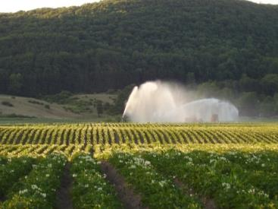
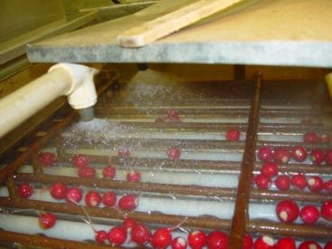
Agricultural Water
Production Water
  Water used in contact with produce during growth
  Irrigation, fertigation, foliar sprays, frost protection
Postharvest Water
  Water used during or after harvest
Notes:
This section has two parts since identification of risks and management of microbial water quality are different during production and postharvest activities.
The FSMA Produce Safety Rule requirements for agricultural water are outlined in Subpart E, § 112.41–112.50.
Water requirements for growing sprouts are included in Subpart E § 112.44(a) and Subpart M of the Produce Safety Rule but are not covered in detail in this module. However, the Sprout Safety Alliance has developed educational materials and a curriculum specifically for sprout producers available at: http://www.iit.edu/ifsh/sprout_safety/
Production water refers to water that meets the definition of agricultural water and is used during growing activities for covered produce, other than sprouts, for the purposes of the Produce Safety Rule (§ 112.44(b)).
Postharvest water encompasses water that meets the definition of agricultural water and is used during and after harvest which can include agricultural water used in the field during harvest as well as during packing or holding activities.

Slide 14
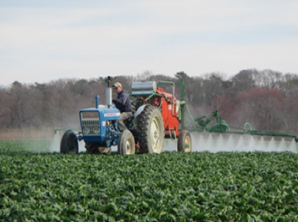
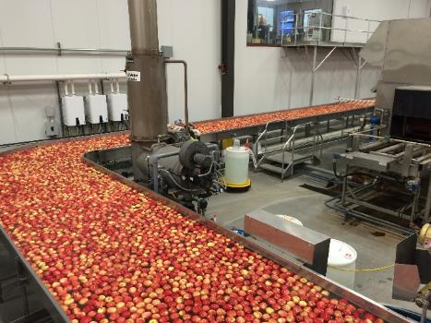
Agricultural Water Quality
All agricultural water must be safe and of adequate sanitary quality for its intended use
  Applies to water used for Production and Postharvest Water
Notes:
A general requirement of subpart E of the FSMA Produce Safety Rule is that all agricultural water must be safe and of adequate sanitary quality for its intended use (§ 112.41). This requirement applies to agricultural water that is intended or likely to contact covered produce or food contact surfaces and includes agricultural water used during growing activities for covered produce using a direct water application method (covered in Part I of this module), and water used for certain activities during and after harvest (covered in Part II of this module) and for sprout irrigation.

Slide 15
Water Quality Criteria for Water Used During Growing Activities
Apply to water used with a direct water application method to covered produce
Each source of production water must be tested to evaluate whether its water quality profile meets the following criteria:
  126 or less colony forming units (CFU) generic E. coli per 100 mL water geometric mean (GM)
  AND
410 or less CFU generic E. coli per 100 mL water statistical threshold value (STV)
Notes:
§ 112.44(b) specifies criteria for untreated agricultural water (both surface water and ground water) that is applied with a direct water application method to covered produce during growing activities.
The numerical GM and STV criteria are used to evaluate the microbial water quality profile (MWQP).
These criteria capture two different pieces of information about the distribution of generic E. coli levels in a water source. The geometric mean (GM) is essentially the average amount of generic E. coli in a water source. The STV reflects the amount of variation in the E. coli levels. Collectively, both pieces of information provide a more complete description of your water quality than either one alone.
Some terms, as defined in § 112.3(c), are critical to understanding the scope of what is covered under these criteria.
Agricultural water means water used in covered activities on covered produce where water is intended to, or is likely to, contact covered produce or food contact surfaces.
Direct water application method means using agricultural water in a manner whereby the water is intended to, or is likely to, contact covered produce or food contact surfaces during use of the water.
Covered produce means produce that is subject to the FSMA Produce Safety Rule. The term “covered produce” refers to the harvestable or harvested part of the crop.
Production water that does not meet the definition of agricultural water (see above) is not covered by the GM and STV criteria in the FSMA Produce Safety Rule. For example, water used for drip or furrow irrigation in apple orchards would not be considered agricultural water as long as the water does not contact the apples. That same water would be considered agricultural water if it were used to mix protective sprays that were then applied directly to the apples.
Additional Resources:
FD&C Act Chapter IV: Food, Section 342 Adulterated Food:
http://www.gpo.gov/fdsys/pkg/USCODE-2010-title21/pdf/USCODE-2010-title21-chap9-subchapIV-sec342.pdf
United States Environmental Protection Agency (EPA) 2012 Recreational Water Quality Criteria: http://water.epa.gov/scitech/swguidance/standards/criteria/health/recreation/upload/RWQC2012.pdf
For information about how the numerical GM and STV water quality criteria were developed
Food and Drug Administration (FDA) (2015) How did FDA Establish Requirements for Water Quality and Testing of Irrigation Water? Questions and Answers with Samir Assar: http://www.fda.gov/downloads/Food/GuidanceRegulation/FSMA/UCM473335.pdf
For a historical context of water quality standards:
Suslow, T. (2009). Standards for Irrigation and Foliar Water Contact. Pew Charitable Trusts at Georgetown University. Produce Safety Project.
http://www.pewtrusts.org/~/media/Assets/2009/PSPWaterSuslow1pdf.pdf
Dufour, A., & Schaub, S. (2007). The evolution of water quality criteria in the United States. Statistical Framework for Recreational Water Quality Criteria and Monitoring, 65, 1.

Slide 16
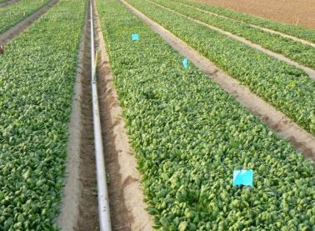
Agricultural Water Requirements
4 years from compliance date
Inspect Water Sources and Water Distribution Systems
  Make repairs/prevent contamination
Build an initial microbial water quality profile
Production Water
Use alternative methods if water source does not meet the requirements
  Allow die off time between irrigation/harvest
  Water treatment
  Drip irrigation (unless it is a root crop)
Notes:
Once growers have assessed the quality of their water source(s) and their methods of application, they should assess risks related to the timing of water applications.
In general, more time between application and harvest reduces produce safety risks posed by the water application.
Additional Resources:
Lopez-Velasco, G., Tomas-Callejas, A., Sbodio, A. O., Pham, X., Wei, P., Diribsa, D., & Suslow, T. V. (2015). Factors affecting cell population density during enrichment and subsequent molecular detection of Salmonella enterica and Escherichia coli O157: H7 on lettuce contaminated during field production. Food Control, 54, 165–175.
Gutiérrez‐Rodríguez, E., Gundersen, A., Sbodio, A. O., & Suslow, T. V. (2012). Variable agronomic practices, cultivar, strain source and initial contamination dose differentially affect survival of Escherichia coli on spinach. J Appl Micro, 112(1), 109–118.
Yuk, H. G., Warren, B. R., & Schneider, K. R. (2007). Infiltration and survival of Salmonella spp. on tomato surfaces labeled using a low-energy carbon dioxide laser device. Hort Technology, 17(1), 67–71.

Slide 17
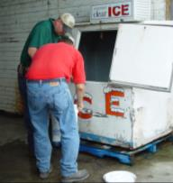
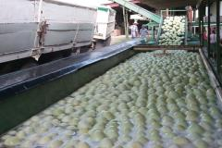
Water Quality Criterion for
Harvest and Postharvest Activities
Water used post harvest must have
no detectable generic E. coli per 100 mL
sample
Treatment not mandated
Change water as necessary to reduce cross contamination risks
Only use sanitizers according to the label
Keep records of water quality/water treatments
Notes:
Water that is used for harvest and postharvest activities must meet the standard of no detectable generic E. coli based on a 100 mL water sample. Untreated surface water must not be used for postharvest uses (§ 112.44(a)). This is a different microbial criterion than applied to production water (water used during growing activities), as discussed in Part I of this module.
Water quality must be tested using EPA method 1603 (modified mTEC) or an equivalent method in accuracy, precision, and sensitivity as described in §§ 112.151(a) and (b).
§§ 112.44(a)(1) to (4) explicitly covers certain postharvest uses:
Used as sprout irrigation water. Please direct any sprout producers to the Sprout Safety Alliance since educational materials have been developed specifically for this commodity.
Any water that directly contacts covered produce during or after harvest activities (e.g., washing, hydro-cooling)
Any water that directly contacts food contact surfaces
Used to make ice that directly contacts covered produce and/or food contact surfaces
Used for washing hands during and after harvest activities
If generic E. coli is detected in the 100 mL water sample or if the agricultural water is determined to not be safe or of adequate sanitary quality for its intended use, the grower must immediately discontinue its use (§ 112.45(a)).
Before resuming use of the water source and/or water distribution system for postharvest uses, § 112.45(a) requires that growers either:
Re-inspect the entire affected agricultural water system to the extent it is under their control, identify any conditions that are reasonably likely to introduce known or reasonably foreseeable hazards into or onto covered produce or food contact surfaces, make necessary changes, and take adequate measures to determine if the changes were effective and, as applicable, adequately ensure that their agricultural water meets the microbial quality criterion in § 112.44(a); or
Treat the water in accordance with the requirements of § 112.43.
§ 112.43(a)(1) requires that when agricultural water is treated in accordance with § 112.45(a)(2) any method used to treat agricultural water must be effective to make the water safe and of adequate sanitary quality for its intended use and/or meet the relevant microbial quality criteria in § 112.44, as applicable.

Slide 18
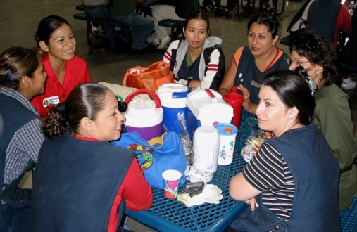
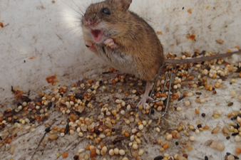
Harvest and Postharvest Practices
No produce destined for fresh market that is contaminated with feces or dropped covered produce
Worker health and hygiene practices
Building must be suitable size, construction and design to facilitate maintenance and sanitary operations
Clean and Sanitize Food Contact Surfaces
  Record of cleaning, sanitizing of tools, equipment and containers is required
Packing containers – new single use or cleaned reusable
Pest Control
Vehicles must be cleaned prior to hauling produce
Break area for eating/drinking
Notes:
Workers are key to ensuring harvest and postharvest activities are done properly, so they must be trained. Worker training was covered in Module 2: Worker Health, Hygiene, and Training but here are some specific requirements that might be valuable to cover again.
§ 112.112 requires immediately prior to and during harvest activities, those subject to the rule must take all measures reasonably necessary to identify, and not harvest, covered produce that is reasonably likely to be contaminated with a known or reasonably foreseeable hazard, including steps to identify and not harvest covered produce that is visibly contaminated with animal excreta. At a minimum, identifying and not harvesting covered produce that is reasonably likely to be contaminated with animal excreta or that is visibly contaminated with animal excreta requires a visual assessment of the growing area and all covered produce to be harvested, regardless of the harvest method used.
§ 112.113 requires that workers must also harvest covered produce in a manner that protects against contamination.
According to § 112.114, covered produce that drops to the ground before or during harvest cannot be distributed (also called dropped covered produce in the glossary). Crops that grow underground (such as carrots), crops that grow on the ground (such as cantaloupe), or crops that are intentionally dropped to the ground as part of harvesting (such as almonds) are not included in this dropped covered produce requirement.
§ 112.22(b) requires that persons who conduct harvest activities for covered produce must also receive training that includes all of the following: (1) Recognizing covered produce that must not be harvested, including covered produce that may be contaminated with known or reasonably foreseeable hazards; (2) Inspecting harvest containers and equipment to ensure that they are functioning properly, clean, and maintained so as not to become a source of contamination of covered produce with known or reasonably foreseeable hazards; and (3) Correcting problems with harvest containers or equipment, or reporting such problems to the supervisor (or other responsible party), as appropriate to the person’s job responsibilities.
§ 112.22(a)(1) requires that worker training include principles of food hygiene and food safety.
Worker clothing and equipment are important and there are requirements for hygienic practices (§ 112.32). Dirty clothes, shoes, and gloves can lead to cross-contamination of produce.

Slide 19
Produce Rule
Crop Exemptions
Exempt from compliance with growing, harvesting, packing and holding requirements
  Produce that is not a raw agricultural commodity
  Produce that is rarely consumed raw
    Examples: White potatoes, Sweet potatoes, Sweet Corn
  Food grains
  Produce that receives commercial processing that adequately reduces the presence of human pathogens

Slide 20
Produce Rule
Farms with Exemptions/Modified Requirements
  Farms that have an average annual value of produce sold during the previous three years of $25,000 or less are exempt
  Only grow produce that receives commercial processing that adequately reduces the presence of human pathogens are exempt except for the following requirements:
    Must annually obtain from the customer that they or an entity the conducts the processing for them has established and follows a process that adequately reduces the presence of human pathogens
    Documents accompanying the produce to the customer and to anyone else that is conducting the process for the customer must state “The food is not processed to adequately reduce the presence of microorganisms of public health concern.

Slide 21
Produce Rule
Farms with Exemptions/Modified Requirements
  Qualified Exemption
    Gross Food Sales averaging less than $500,000 annually during the previous three years
      FDA Definition of food includes non covered produce, animal feed (including growing grain, hay, etc.), livestock, poultry, processed food (includes contract production)
    Direct food sales to consumers and/or to restaurants and retailers in the same state or not more than 275 miles away must exceed sales to all others combined
    Modified requirements
      Provide the name and complete business address of the farm where the produce was grown either on a label or at the point of purchase
      Farm must maintain sales records subject to inspection to verify exemption status
        Records are not required to be submitted to MDA or FDA
        Will be inspected on site
      Farm must review sales records and document the review annually to verify they still meet the Qualified Exemption requirements
    Exemption can be revoked
      Active investigation of food borne illness linked to farm
      If determined necessary to protect public health
    Unlikely that retailers will buy from Qualified Exempt Growers unless they are in compliance

Slide 22
Produce Safety Rule Compliance Dates
Very small businesses with $25,000 to $250,000 in average annual produce sales during the previous three year period: January 26, 2020
Small businesses with more than $250,000 and up to $500,000 in average annual produce sales during the previous three year period: January 26, 2019
Qualified Exemption:
  Labeling requirements: January 1, 2020
    Name and address of grower must be on label or posted on sign
  Retention of records supporting eligibility:
    Over $250,000 in food sales – January 26, 2016
    $25,000 to $250,000 in food sales – January 26, 2017
Businesses with more than $500,000 in produce sales: January 26, 2018
  Inspections have been delayed until 2019
  Produce Growers are still required to be in compliance with the Rule
  Cause inspections will be conducted (implicated in food borne illness outbreak)
Compliance with certain aspects of the water quality standards and related testing and recordkeeping provisions – By four years beyond the compliance dates for the rest of the final rule

Slide 23
What do I do now?
Required by Produce Safety Rule
  Attend a Produce Safety Alliance Produce Safety Rule Training for Growers
    Keep your Association of Food and Drug Officials Certificate in a safe place
  If you think you meet the Qualified Exemption standard, keep records of:
    Dollar value of food sales
    Dollar value of produce sales
    Where produce was sold (location and type of business)
    Produce that was sent for further processing with a kill step
  Start implementing compliant practices
    Worker Health, Hygiene and Training
    Begin Testing Agricultural Water to determine if you need to make changes
Not Required by Produce Safety Rule (will assist with compliance)
  Attend a Basic/Advanced GAP training
  Write and Implement a Food Safety Plan
  Consider GAP certification
  Request a Readiness Review
  Request technical assistance through UMD or UME
Check the MDA FSMA web page for updates

Slide 24
Additional Resources for Produce Growers
Maryland GAP Program
Food Safety Plan that covers:
  Water Quality
  Biological Soil Amendments
  Worker Health and Hygiene
  Domestic and Wild Animals
  Sanitation of harvest and post harvest tools, equipment, baskets
  Meeting standards would be compliant with Produce Safety Rule
MDA/UMD/UME offer
  Basic & Advanced GAP Training
  Assistance with Food Safety Plan Writing
No cost MDA GAP Inspections
No Cost MDA GAP Certification
Cost Share for USDA GAP/GHP and USDA Harmonized Audit Fees ($108 per hour)

Slide 25
Upcoming Food Safety Training
Check the MDA website for registration
January 10, 2018 On-farm Food Safety and Recall Readiness Training for CSA Operators Cecilton
January 16, 2018 Basic GAP Cockeysville
January 19, 2018 On-farm Food Safety and Recall Readiness Training for On-Farm Market
January 25, 2018 On-farm Food Safety and Recall Readiness Training for Agritourism Operators
February 5, 2018 Basic GAP Queenstown
February 12, 2018 Produce Safety Rule/Preventive Controls for Human Food Salisbury
March 12, 2018 Advanced GAP (Emphasis on Water Quality/Testing and Distribution Systems) Annapolis
Two other Produce Safety Alliance Produce Safety Rule trainings are being planned for February/March – Frederick and Baltimore County

Slide 26
Food Quality Assurance Program
Contact Information
Deanna Baldwin
410-841-5769
Deanna.Baldwin@maryland.gov
Molly Gillingham
410-841-5769
Molly.Gillingham@maryland.gov
Justine Beaulieu
301-405-7543
jbeauli1@umd.edu
http://mda.maryland.gov/fsma
Funding for this informational session was made possible, in part, by the Food and Drug Administration through grant PAR-16-137. The views expressed in written materials or publications and by speakers and moderators do not necessarily reflect the official policies of the Department of Health & Human Services; not does any mention of trade names, commercial practices, or organization imply endorsement by the United States Government.

