Slide 1
Outbreak Response
What to Expect
D’Ann L. Williams, DrPH, Kyle Shannon, LEHS
Maryland Department of Health
Office of Food Protection
Deanna Baldwin
Maryland Department of Agriculture
Food Quality Assurance Program

Slide 2
MISSION AND VISION
MISSION
The mission of the Prevention and Health Promotion Administration is to protect, promote and improve
the health and well-being of all Marylanders and their families through provision of public health
leadership and through community-based public health efforts in partnership with local health
departments, providers, community based organizations, and public and private sector agencies, giving
special attention to at-risk and vulnerable populations.
VISION
The Prevention and Health Promotion Administration envisions a future in which all Marylanders and
their families enjoy optimal health and well-being.

Slide 3
Objectives
What is an outbreak ?
How do we make the connections?
Outbreak Investigation Process
How this may affect you
The Investigation
Interviews with persons reportedly ill
Interviews with responsible parties
Review of records
Environmental and Product Sampling
Types of Sampling
Preparing for the Investigation
Examples of Outbreaks - Discussion

Slide 4
What is an Outbreak
2 or more persons (not in the same family) report illness they suspect was caused by one of the consumption of a food product
Cases may be reported by a Doctor, laboratory analysis of clinical samples, or an individual, or by surveillance programs
Foodborne illnesses are reported to Health Department
Resulting cluster of illnesses caused by the same pathogen will initiate a response and investigation

Slide 5
Other situations that may triggers an investigation
Routine or surveillance sampling conducted by local, state or federal agencies
Samples collected by other states or federal agencies in response to an ongoing outbreak
Quality/Safety testing by customers

Slide 6
How do we make the connection?
Current lab technology can identify pathogens by genetic molecular typing Pulse Field Gel Electrophoresis (PFGE) or Whole genome sequencing (WGS)
“PFGE is like comparing 2 books based on the length of the chapters, WGS is like comparing the books letter by letter”
WGS identifies the complete DNA sequence of an organism's genome not just Salmonella Newport but Salmonella Newport 10 or 61 not just Listeria monocytogenes but Listeria monocytogenes 1/2a, 1/2b, 1/2c, and 4b.
Whole genome sequencing can further pin point the pathogen that caused illnesses and can also be identified in an environmental sample or food product to connect cases across the state or nation.

Slide 7
Outbreak Investigation Process
Questionnaires administered to outbreak cases to try to identify
common food consumption (type of food)
Common food source (events, restaurants, retailers, farmer’s markets, CSA, farm stands)
Investigations are conducted at restaurant, retailer, event organizers to evaluate food safety practices (food source, proper holding temperatures, cooking, employee hygiene, employee illness)
Traceback investigation to collect invoices, records documentation to determine the source of the implicated food
Consumer → Restaurant →Restaurant/Wholesale/Broker Supplier→Produce Grower
Getty Images
Notes:
Deanna noted that there a lot of questions about it got back to the source and why isn’t the restaurant or distributor being looked at. This is were can potentially address this.

Slide 8
Goal of the Investigation
Identify the root cause of the outbreak
Ensure contaminated product is removed from distribution
Prevent future outbreaks with lessons learned
There can be regulatory repercussions for distributing adulterated food

Slide 9
How it may affect you
If a produce grower is implicated through the traceback process, an investigative team that may include MDA, MDH and FDA (if outbreak was interstate) will notify the farm and set up an onsite visit
FDA plans to have an FDA Produce Safety Network representative lead the FDA portion of the investigation (interstate) with the implementation of the Produce Safety Rule
Typically you would be first contacted by a representative of MDA or the LHD
During the on farm investigation questions about food safety practices and distribution of implicated produce will be asked

Slide 10
The Investigation - Be Prepared for Questions
An outbreak investigation questionnaire will be administered
Do you have records documenting where you sold the implicated product; harvest dates; quantities sold will be requested
Do you have a complaint notification plan?
Do you have a recall plan?
Do you have a food safety plan?
They will be evaluating the “culture of safety” on the farm

Slide 11
The Investigation - Be Prepared for Questions
Remember the 4 W’s? Workers, water, wildlife, waste - ADD OTHER
Workers
Worker Health
Employee illness policy, provisions
Worker Hygiene Practices
Access to toilet facilities
Access to adequate handwashing
Break area, personal item/food storage

Slide 12
The Investigation - Be Prepared for Questions
Water
Location of fields where the implicated produce was grown
Irrigation and Post Harvest Water Quality and Source
Livestock/poultry on the farm (separation from water/crops)
Sanitation and cleaning practices
Flooding or other storm events that may affect water sources or crops

Slide 13
The Investigation - Be Prepared for Questions
Wildlife
Wildlife/Domestic Animal Intrusion in produce fields
Location in proximity to fields where the implicated produce was grown
Livestock/poultry/petting area on the farm (separation from produce)
Other activities that could contribute to the contamination of crops

Slide 14
The Investigation - Be Prepared for Questions
Waste
Use of biological soil amendments
source,
application dates
composting records
Wildlife/Domestic Animal waste in produce fields
Livestock/Poultry/Petting Zoo on the farm

Slide 15
The Investigation - Be Prepared for Questions
Other
Transportation
Food contact equipment (harvest baskets, harvest knives, packers, flumes, dump tanks)
Cleaning practices
Storage areas
Volunteer/Guests training, hygiene access, agreements
Events (flooding, storm), areas or activities that could contribute to the contamination of produce
They will be evaluating the “culture of safety” on the farm

Slide 16
Investigation – Environmental and Product Sampling
Conducted to determine if the pathogen that caused the outbreak can be detected on the farm
To assist in identifying the root cause of the product contamination
When conducting environmental sampling, the investigative team will wear disposable gloves, clothing and booties. This is not to protect the investigative team, it is to ensure the team does not contaminate your equipment, product, or the samples during the sampling process
Note: FDA and States conduct routine sampling of produce collected from farms – pesticide residue and/or pathogens
Notes:
Note that in many cases pathogen testing will be done in response to an event

Slide 17
Investigation - Types of Sampling
Swabs of equipment such as packers, harvest baskets, knives, belts, dump tanks
Soil samples
Samples of biological soil amendments used
Irrigation and Post Harvest water samples
Surrounding water (rivers, streams, etc.) samples
Product (ex. cucumbers, radishes, etc. that were implicated in the outbreak)
Notes:
Do we want to note anything about employee restrictions and stool culturing here?

Slide 18
Be Prepared for the Investigation
Responsible individual(s) on site during the visit that is knowledgeable about production, harvest and post harvest practices
Answer questions and provide any documentation on food safety practices
Provide a neutral setting for the regulators to interview/review records
Have records readily available for your harvest locations, dates and sales
Records for any produce purchased from another farmer/distributor
Most of these records are not mandated by law however they:
Can assist in quickly ending an outbreak; reducing the quantity of implicated product; documenting best practices for food safety were followed; and most importantly preventing future outbreaks
Notes:
We may want to mention how we determine the “time frame of interest”

Slide 19
Scenario 1 –C. bot, Pine Nut Basil Pesto
Hospital notifies HD of 2 cases of Clostridium botulinum, reported 12 days apart
Questionnaire reveal that both patients shared a meal of pesto purchased from an on-farm stand in CA
Pesto sent for C. bot testing Botulism toxin was found in the product
Investigation indicated no license for producing jarred foods, inadequate knowledge of canning food processing, no monitoring records kept during processing
Lead to recall of jarred products from farm and HD issued internet and social media posts advising consumers not to eat Farm A jarred products

Slide 20
Scenario 2 – Salmonella and Cantaloupe
Multiple salmonella illness are reported to HD at a State run facility
Investigators collect menus, collect data on what the ill patients ate and what the ones who did not get ill ate, cantaloupes were determined to be the most likely food source
Investigators collect invoices and other documents for distributor that trace the product back to one cantaloupe supply farm
An investigation is conducted on the farm to review production records, harvest and production processes, and good agricultural practices.
Cantaloupes and environmental swabs are collected from the farm and processing area
Laboratory analysis finds Salmonella in both the cantaloupe and on the processing conveyer belt

Slide 21
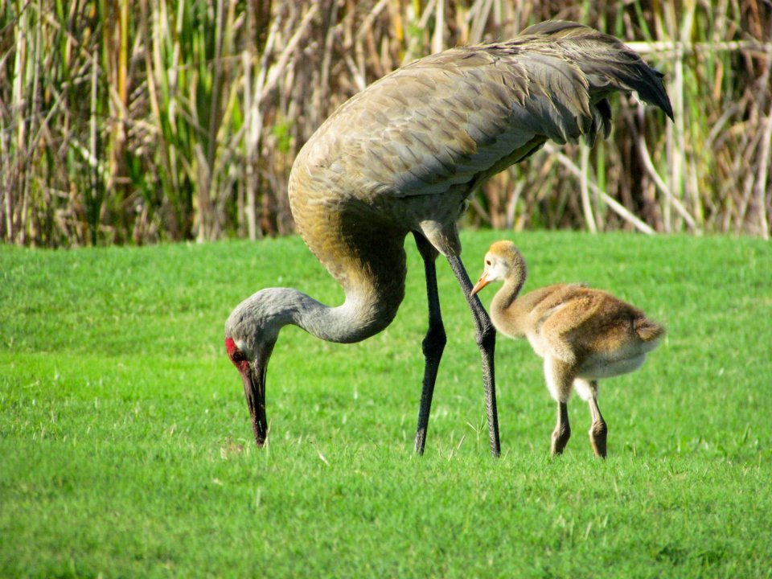
Scenario 3 – Campylobacteriosis – Raw Peas
Surveillance detected an above average number of Campylobacteriosis
Health alert from HD increased physician reporting
Questionnaire data from patients implicated raw peas grown in Alaska
Investigators traced peas back to vendors (3 grocery, 5 farmer’s markets) and then to source farm Peas were sold raw, with no instructions to blanch before eating or freezing
Owner reported Sandhill crane flock visited the pea fields daily during harvest time
Soil, water, processing surface samples, Sandhill crane feces collected
Lack of chlorine residual in pea processing water, inadequate plumbing, insanitary conditions in processing area, no animal exclusion provisions

Slide 22
Scenario 4 – E. coli Outbreak – Goat Farm
41 cases of E. coli, 10 cases hospitalized
Questionnaires found common exposure was a visit to a local farm, with ill patients reporting petting or even bringing kid goats home
Analysis of farm products did not find E. coli
Environmental analysis was conducted and E. coli was found on gates, a concrete floor and a bale of hay where children sat, holding the kid goats
Sanitation examined, absence of hand washing stations may have contributed to the outbreak among farm visitors
Soap and clean running water and clean towels must be available for workers and visitors to wash hands, immediately upon exiting areas containing animals
Boots can also spread contaminants into processing areas

Slide 23
Scenario 5 – E.coli & Farm Stand Strawberries
15 ill, 4 hospitalized, 2 HUS (hemolytic uremic syndrome), 1 died
Questionnaire administered, all reported eating strawberries purchased a local farmer’s market
Investigations with the farmer’s market vendors, secondary vendors and local fruit stands
Difficulty tracing based on multiple sources of strawberries, no lot numbers or identifying information
Eventually traced back to 1 farm, attempts to pinpoint field or cause multiple farm investigations, deer feces confirmed by molecular typing
Health Department concerns about frozen and uncooked strawberry jams

Slide 24
Scenario 6 – Routine and Surveillance Sampling
Some state and federal programs collect routine or surveillance samples
Especially if they have seen past outbreaks or recent outbreaks in state surrounding them
In addition if contaminant strains reappear that were previously associated with illnesses or outbreaks, increased surveillance may occur

Slide 25
Next steps if your product is implicated? Recovery and Prevention
Respond to any requests from the regulatory agencies
Correct any issues identified during the investigation
Communicate with the regulatory agencies and your buyers
Evaluate your food safety practices to identify food safety risks that could have caused product contamination
Review and improve or create traceback and recall plan

Slide 26
Next steps if your product is implicated? Recovery and Prevention
Consider water treatments or alternative water source if surface water is used for irrigation and tests positive for pathogens identified in the outbreak
Review and improve sanitation and worker hygiene practices
Reassess your land use on the farm to identify potential cross contamination issues
Evaluate the effectiveness of cleaning procedures for tools and equipment that contact produce
Participate in the MDA/UMD environmental sampling program
Sampling conducted by Justine Beaulieu UMD and submitted blind to MDA lab
MDA does not know which farm the samples are from
Purpose: Identify areas of concern and fix them before they create a problem for you

Slide 27
Response and Communication
Coordination and collaboration between multiple Local, State and Federal agencies
There should be a clear understanding of why the regulators are there and the reasons for their questions/sampling
Don’t be afraid to ask questions of the regulators
Breakdown in communications can happen between agencies

Slide 28
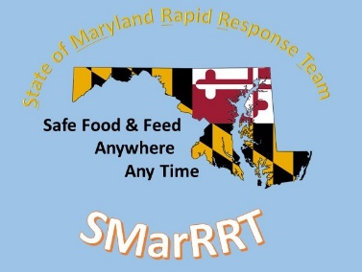
Maryland Department of Agriculture http://mda.maryland.gov/foodfeedquality Maryland Department of Health Prevention and Health Promotion Administration
D’Ann L. Williams, DrPH, MS, LEHS
Rapid Response Team
410-767-2633
dann.williams@maryland.gov
Kyle Shannon, LEHS
CMDPS
410-767-8660
kyle.shannon@maryland.gov
Deanna Baldwin
Maryland Department of Agriculture
Food Quality Assurance
410-841-5769
Deanna.baldwin@maryland.gov

